Slide 1



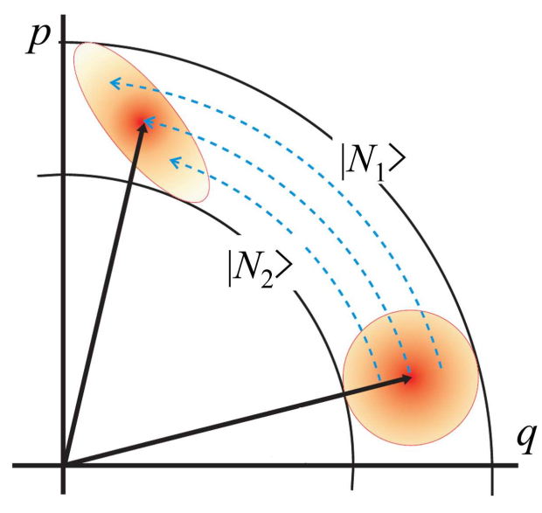
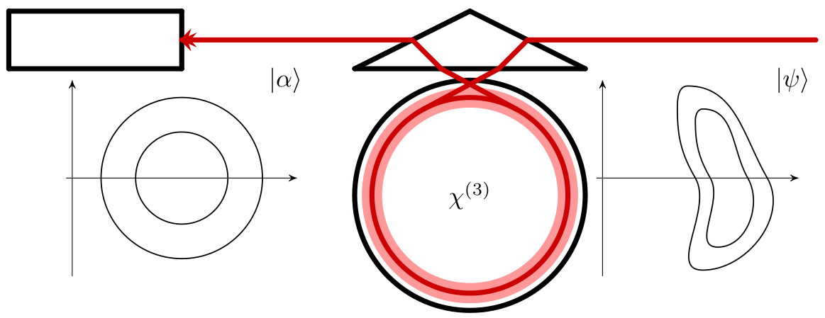


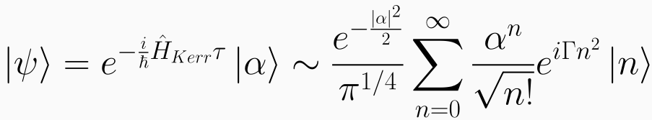
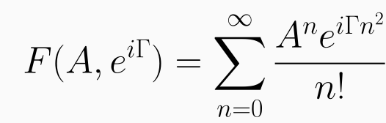

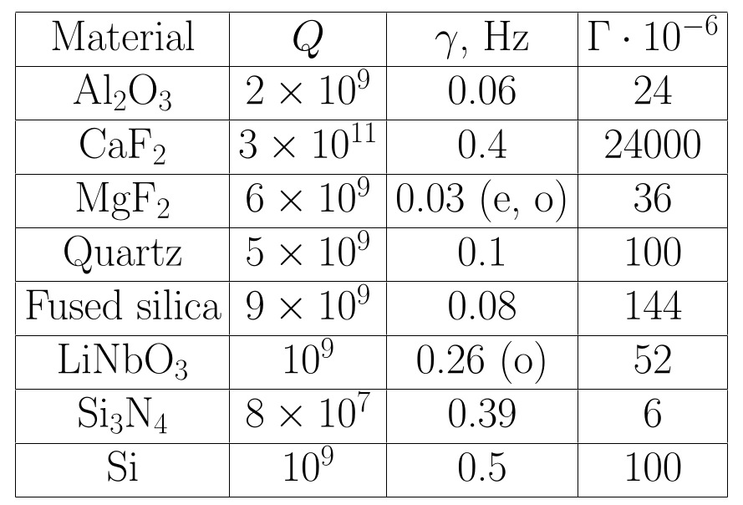
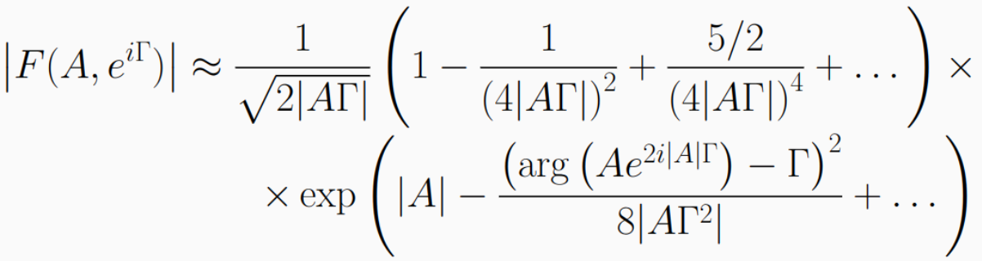

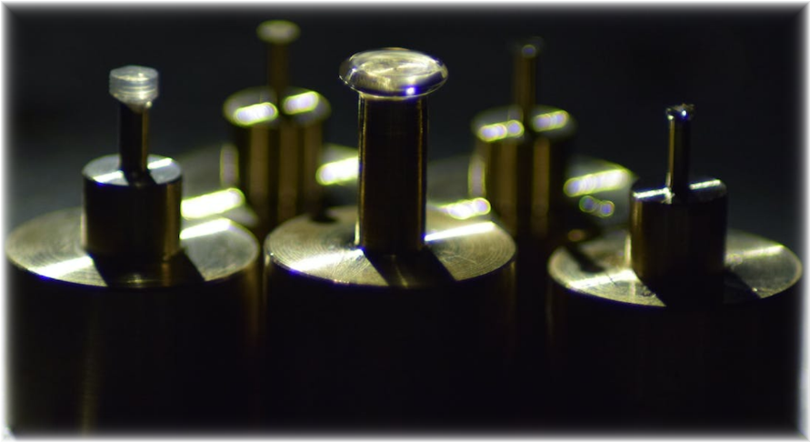
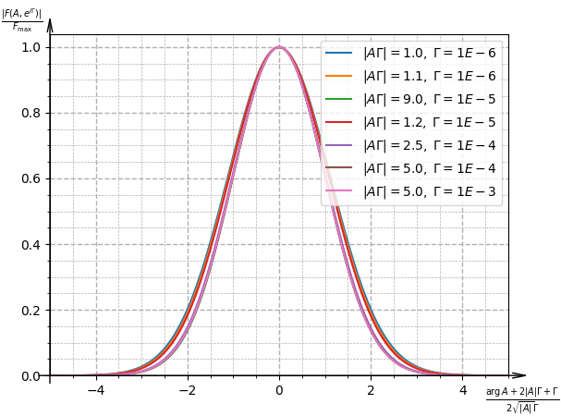
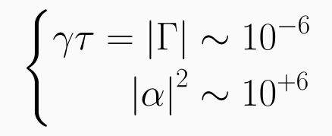
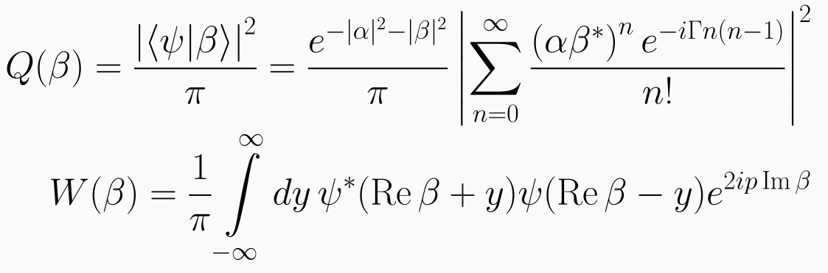


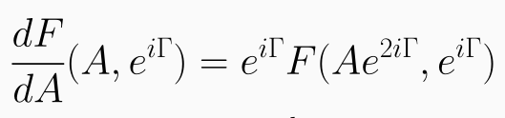
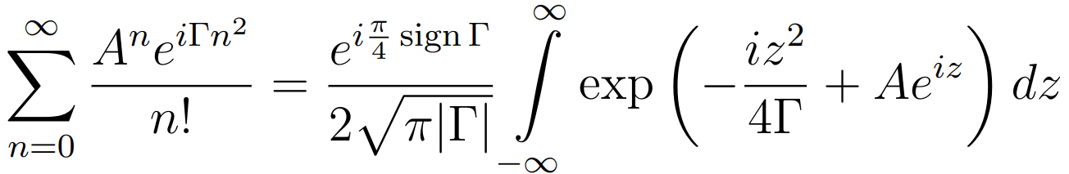
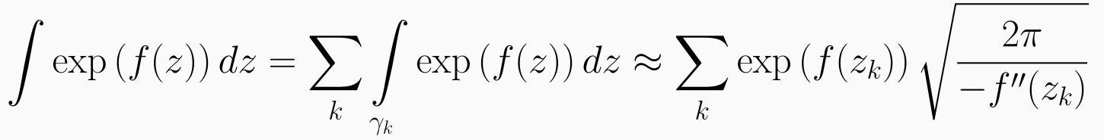
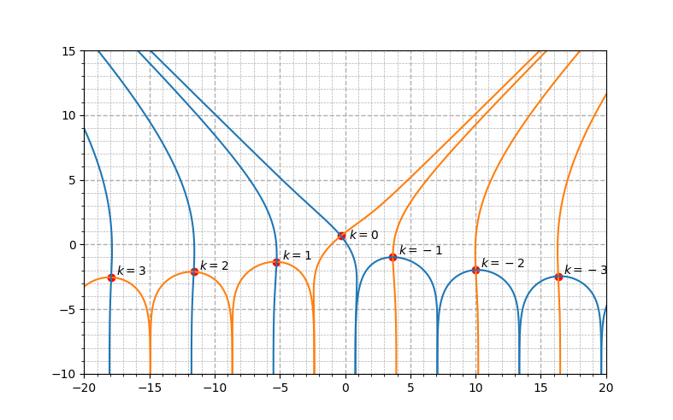
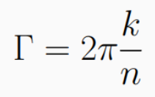
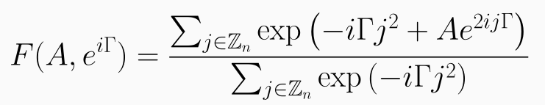
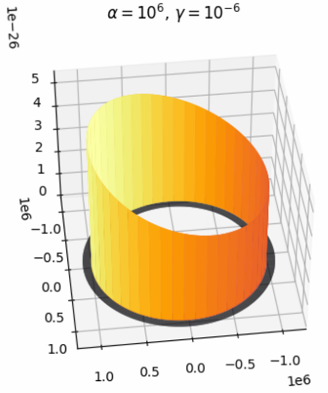
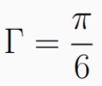
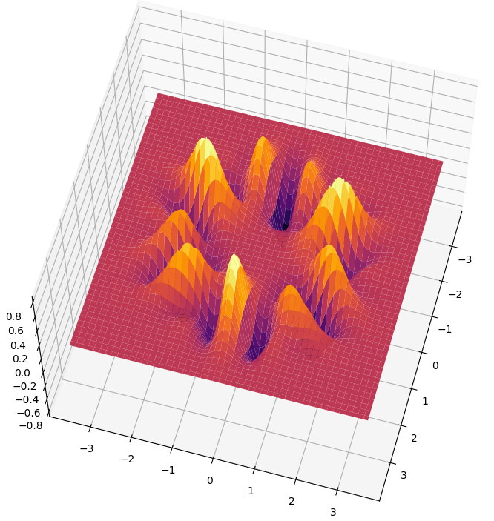
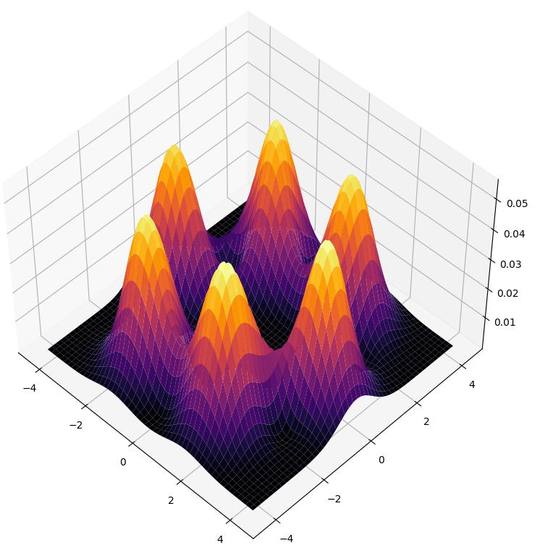
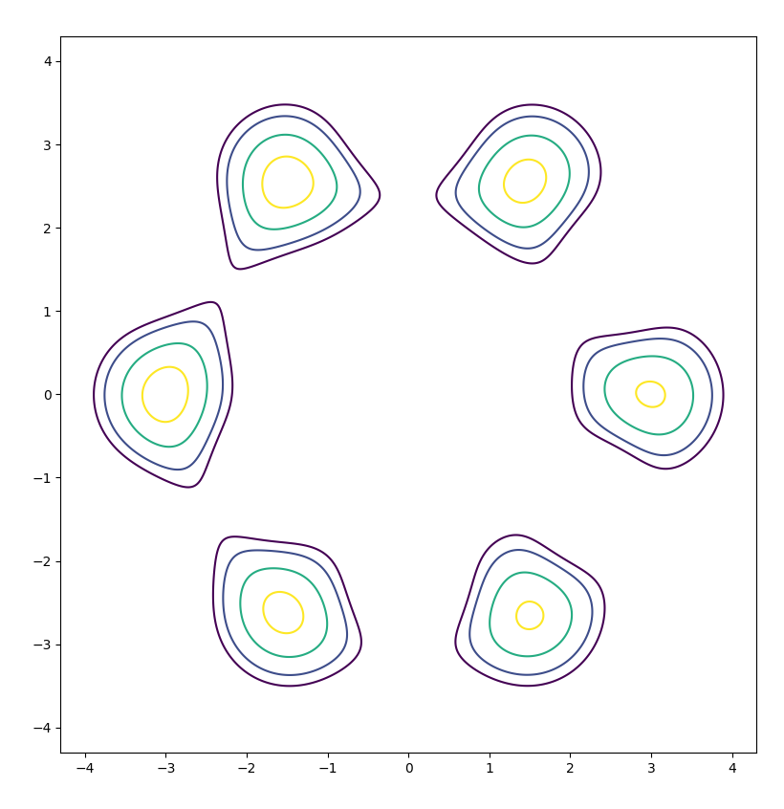

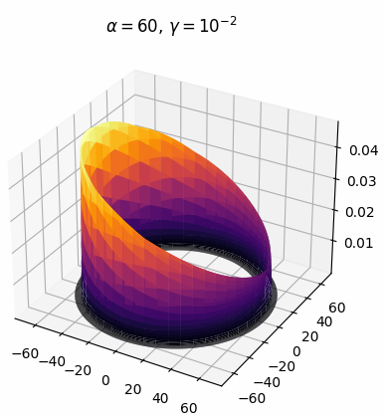
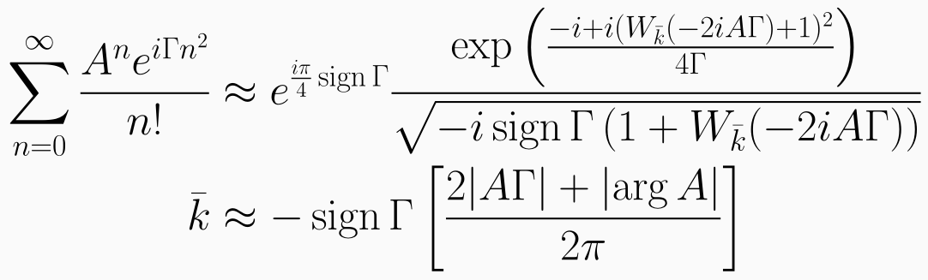
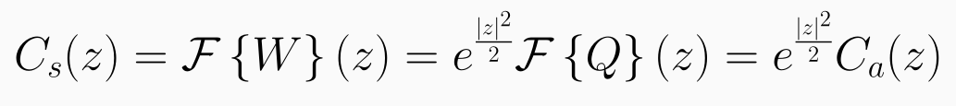

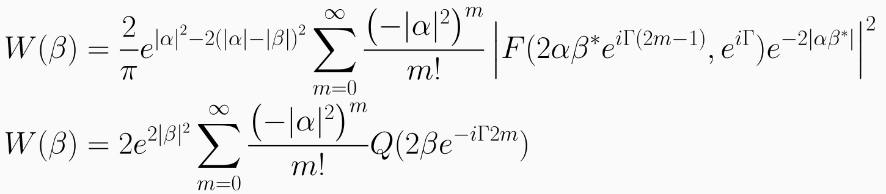

Quasiprobability distributions of bright ‘‘banana’’ states
Feel free to write to me!
I'll send you the article as soon as I write it...)
Nougmanov Boulat
Moscow Institute of Physics and Technology
Russian Quantum Center
nugmanov.bn@phystech.edu
Abstract
Due to the nonlinear self-phase-modulation effect, coherent states of light in optical media having cubic nonlinearity evolve to non-Gaussian so-called ‘‘banana’’ states. We develop a fast and convenient formalism of calculation of quasiprobability distributions of bright (multiphoton) banana states.
Motivation
Scheme
Basic idea
We study the evolution of coherent state of light in Kerr-nonlinear medium:
The main problem is to calculate quasi-probabilistic functions in a reasonable time. Instead of studying series which appears in Husimi function let's study function that has less arguments and simpler behavior:
With low nonlinearity , it is necessary to study a state with a LARGE mean number of photons to observe SPM:
The experimental realization of the bright non-Gaussian quantum state is feasible in WGM cavity with high quality factor, and strong nonlinearity.
The resulting state is studied in terms of Husimi and Wigner functions:
The best performance archived for cubically nonlinear media in microresonators. is defined by archived quality with non-linearity determined by the material.
Husimi calculation
Wigner calculation
Firstly we rewrite the expression for using principal value integral:
We start with the functional differential equation:
Then we will use the complex method of steepest descent. In general terms it consists of the following:
It connects the value of the derivative with the value at another point. With rational , you can repeatedly take the derivative, which will connect the values of the derivative and the function at one point, making the equation solvable.
Values of Husimi function
Wigner graph at
Husimi graph at
Finally, given one transition point at number , which makes the greatest contribution, we find an approximate expression for the function :
There is a connection between the functions of Husimi and Wigner through characteristic functions:
After the transformations, one can go to the limit of any irrational :
For VERY LARGE , we have to take into account not only , but also its neighbors, which increases the complexity of calculations to
Here we can see how at high intensities the "banana" state twists so much that it has complete uncertainty in phase.
Conclusions
References
The method for finding the Husimi function of a bright "banana" state in time is found.
2. The formula is proposed for the connection of the quasi-probabilistic functions of Husimi and Wigner of the "banana" state.
1, Kitagawa, M., & Yamamoto, Y., Physical Review A 34, 3974 (1986).
2. Balybin, S. N., Khalili, F. Y., Strekalov, D. V., Matsko, A. B., & Bilenko, I. A., Proc. SPIE 11558, 115580A (2020)
3. Strekalov, D. V., & Leuchs, G., in "Quantum Photonics: Pioneering Advances and Emerging Applications", 51-101 (2019).
4. Rosiek, C.A., arXiv:2202.02285 (2022) .

